Slide 1
Engaging in Reflection for You and Your Students
Lauren Epps & Casey Carroll
Notes:
Casey

Slide 2

Learning Objectives
Define reflection and its purposes
Describe the DEAL model of reflection
Practice writing guided reflection questions
Reflect on your first-year faculty experience
Notes:
Casey
In this session, you will explore the reasons and meaning behind purposeful reflection. You will consider reflection from personal and student perspectives and practice practical applications to use with your students and in your own growth as you plan for your next year as faculty.

Slide 3
CIEL Overview
Notes:
Lauren

Slide 4
MISSION
VISION
To advance integrative and experiential learning across within and beyond the classroom experiences at the University of South Carolina Columbia and Palmetto College campuses for students, faculty, and staff by providing programs, developing resources, conducting outreach, and facilitating assessment.
To foster an enriched educational environment through purposeful within and beyond the classroom experiences that deepen the impact on student learning and enhance their preparation for the future.
Notes:
Lauren

Slide 5
CIEL HISTORY
2011 | USC Connect Quality Enhancement Plan
2012 | Integrative Learning grants USC Connect Opportunities database
2013 | Graduation with Leadership Distinction (GLD)
2015 | UNIV 401 for GLD
2017 | Faculty Fellows
2018 | Experiential Learning Opportunities (ELOs)
2020 | Center for Integrative and Experiential Learning (CIEL) name change IEL Certificate
2021 | My USC Experience database Experience by Design Quality Enhancement Plan
2022 | Faculty and staff reflection and logistics support
2024 | GLD nominations & alumni awards
2026 | GLD growth & pathway updates
Notes:
Lauren

Slide 6
DEFINING EXPERIENTIAL LEARNING
Significant time and effort
A minimum of 45 hours of engagement in which students are applying learning in a real world context. Hours can include time spent in preparation for and reflection on the experience.
Clear expectations
Expectations for participation are shared with students in written form (e.g., syllabus, guide, or handbook) and/or through individual or group meeting sessions.
Required reflection
Students reflect on learning and its application through assignments (e.g., projects, papers, presentations), journals, blogs, group sessions, or one-on-one meetings.
Feedback
Students receive feedback from a faculty, staff, or a graduate assistant (as well as potential peer feedback) on their participation and/or learning.
Source: Adapted from AAC&U definition of experiential learning
Notes:
Lauren

Slide 7
DEFINING INTEGRATIVE LEARNING
“Connecting skills and knowledge from multiple sources and experiences; applying theory to practice in various settings; utilizing diverse and even contradictory points of view; and understanding issues and positions contextually.”
Source: Huber and Hutchings, Mapping the Terrain, 2004 AAC&U
Notes:
Lauren

Slide 8

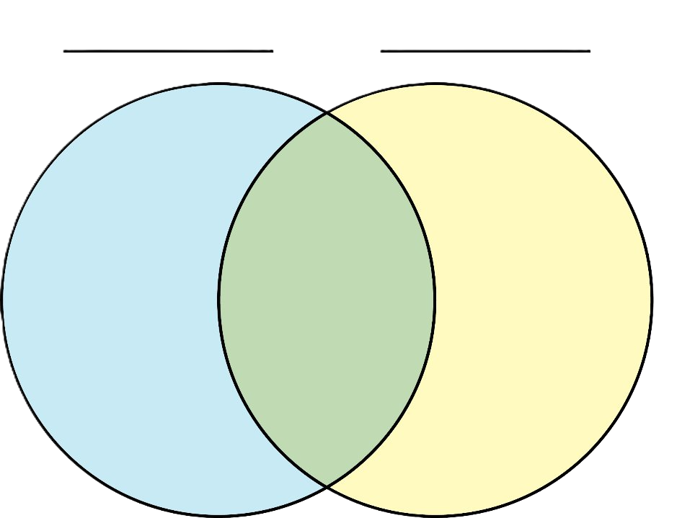
INTEGRATIVE LEARNING
WTC
BTC
The Center for Integrative and Experiential Learning is about helping students get the most out of their collegiate experience by helping them make connections between what they learn within courses and their involvement beyond the classroom.
Community service
concepts
Study abroad
Academic Courses
Integrative Learning
Experiences Beyond the Classroom
frameworks
Peer
leadership
theories
Research
Notes:
Lauren
WTC = Within the Classroom
BTC = Beyond the Classroom

Slide 9
Orientation Leader
(ELO)
SPTE 295
(ELO)
Undergraduate Research
(ELO)
Integrative Learning
Connections from
within and beyond
the classroom
ELO = Experiential Learning Opportunity
SPTE 295 = Practicum in Sport and Entertainment Management
Notes:
Lauren

Slide 10
WHAT CIEL OFFERS
EL resources
  ELO course designation
  My USC Experience database
Reflection resources
  DEAL model tools
  Reflection station
  GLD
Support
  ELO/GLD course proposals
  BTC logistics
Notes:
Lauren

Slide 11
WAYS TO GET INVOLVED WITH CIEL
Use reflection resources (prompts, station, etc)
GLD – nominate your students!
ePortfolio reviewer
Discover USC presentation reviewer
Faculty Fellow
UNIV 401 instructor
Submit courses for GLD course lists
Submit courses for approval as Experiential Learning Opportunity (ELO)
Earn IEL Certificate through CTE
Notes:
Lauren
End by 10:20

Slide 12
Think – Pair – Share
Notes:
Casey

Slide 13
Individual Reflection
On your own, jot down responses to these 3 questions:
  What is reflection?
  What are the benefits and challenges of reflection?
  How do students perceive reflection?
Notes:
Casey
1-2 minutes

Slide 14
Partner Reflection
With a partner, share your ideas:
  What was similar or different in your definitions of reflection?
  How might benefits and/or challenges differ by discipline or student population?
  What factors might impact students' perceptions?
Notes:
Casey
2-3 minutes

Slide 15
Barriers to Reflection
A "What If" Challenge
Notes:
Casey

Slide 16
Scenario #1: Imagine you are an undergraduate student...
You just finished a fast-paced community-based activity in class. Your instructor asks you to write a reflection right now, before you’ve had time to process. How are you most likely to feel?

Slide 17
Scenario #2: Imagine you are a graduate student...
After putting real effort into writing a thoughtful reflection, your instructor never comments on it or discusses the themes in class. How would you feel?

Slide 18
Scenario #3
Your instructor assigns a reflection but just says, “Write about your experience,” with no specific prompts. What will you most likely produce?
Notes:
Expect to hear – vague, generic, shallow/surface level

Slide 19
Scenario #4
Your Dept Chair asks you to complete a reflection task and you receive a lengthy prompt with multiple paragraphs of instructions and seven sub-questions. How do you feel about the task? What is your strategy for completing it?
Notes:
Examples – teaching philosophy, annual review letter
Transition – bad prompts and struggles can be barriers to reflection, DEAL model can make it easier

Slide 20
DEAL Model
Notes:
Lauren

Slide 21
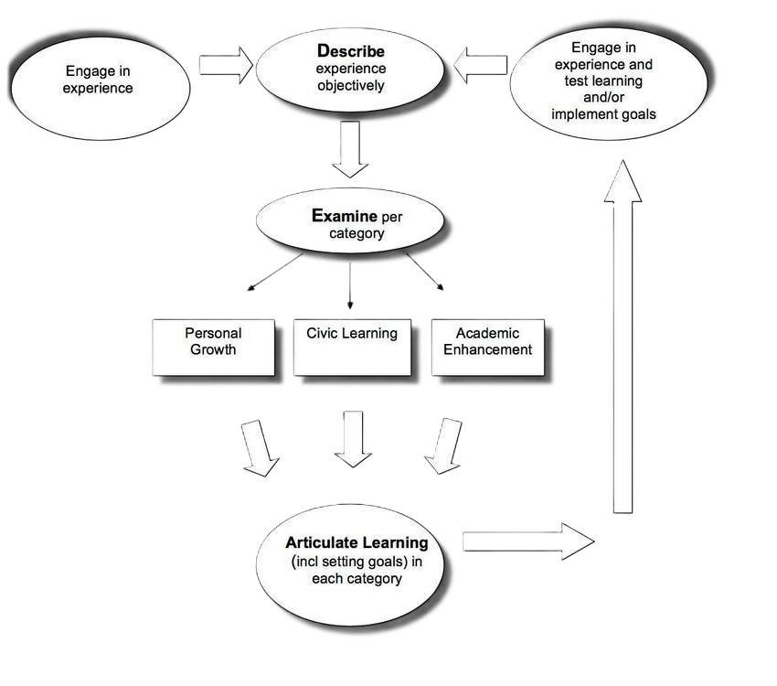
Source: Ash & Clayton, 2009
Notes:
Lauren

Slide 22
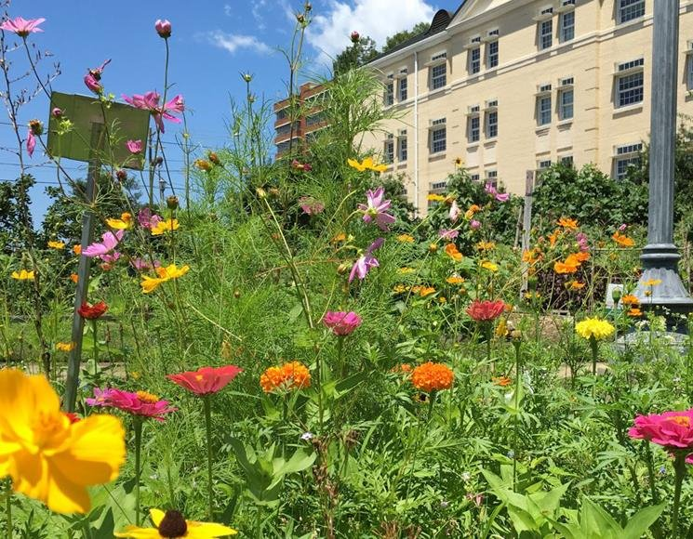
UNIV 101 VISIT TO SUSTAINABLE CAROLINA GARDEN
1. Describe your experience.
  When did this experience take place?
  Where did it take place?
  Who else was there?
  What did you do?
  What did others do?
  What actions did you specifically take?
Notes:
Lauren
Give choice – choose what is most meaningful for you. Even that choice is part of the process of reflection
Describe – boring but intentional

Slide 23
UNIV 101 VISIT TO SUSTAINABLE CAROLINA GARDEN
2. Examine your assumptions, expectations, and personal goals.
  What are some of the characteristics of the experience you were looking forward to and/or curious about leading up to your participation?
What assumptions or expectations did you bring to the situation?
How did they affect what you did or didn't think, feel, or do?
To what extent did they prove true? Why or why not?
  In what ways did you succeed or do well in this activity and what personal characteristics helped you be successful?
  In what ways did you have challenges and what personal characteristics contributed to the challenges?
  Will you continue pursuing similar engagements in the future? Why or why not?
Notes:
Lauren

Slide 24
UNIV 101 VISIT TO SUSTAINABLE CAROLINA GARDEN
  3. Articulate your learning.
"I learned that ..." (Think about a significant takeaway you had or something you learned about yourself as a result of participating in this activity, not a statement of facts.)
  "This experience is similar or different to what I learned in/from ..." (Identify a course, experience, and/or perspective that resonated with the takeaway you described above.)
  "In light of this learning I will ..." (What actions will you maintain or change as a result? How will this new learning impact your decisions moving forward?)
Notes:
Lauren
Specific prompts beneficial for first-year students or students in disciplines that don’t often practice written reflection

Slide 25
Your Turn!
Notes:
Lauren

Slide 26
Practice DEAL
Choose an assignment
Write 3 reflection questions
  Describe
  Examine
  Articulate Learning
Share with your partner
Notes:
Lauren
End by 11:10

Slide 27
Personal Reflection
Notes:
Casey

Slide 28
REFLECT ON YOUR FIRST YEAR AS A FACULTY MEMBER AT USC...
Goals:
Stop and breathe!
Identify lessons that can help in the future
Possible formats:
Journal entry
Email (send later)
Future calendar reminder
Notes:
Casey
Take the next few minutes to practice doing your own reflection on your first year as a faculty member at USC.
Follow the prompts on the slide or feel free to free style.
Consider writing this out as a letter to your future self. What aspects of your learning from this year to you want to remind yourself to keep in mind or take action on in August? In outlook, you can write an email and then set it up to send later using the send button. I personally use calendar events to set reminders for myself for later.
Possible prompts: I actually love the ones on the slide. I think the framing is the main thing to update.
We could specify specific roles maybe? Like an Articulate Learning prompt for teaching and research? Maybe even something about personal growth or work life balance?

Slide 29
REFLECT ON YOUR FIRST YEAR AS A FACULTY MEMBER AT USC...
Describe:
  What did you do? What did you not do? Who has supported you?
Examine:
  What were your expectations going in? To what extent did they prove true or untrue?
  What personal characteristics have helped you be successful?
  What areas of growth still exist?
Articulate Learning:
  What is one significant takeaway from this year?
  In light of this learning, what will you do differently next year?
Notes:
Casey
Take the next few minutes to practice doing your own reflection on your first year as a faculty member at USC.
Follow the prompts on the slide or feel free to free style.
Consider writing this out as a letter to your future self. What aspects of your learning from this year to you want to remind yourself to keep in mind or take action on in August? In outlook, you can write an email and then set it up to send later using the send button. I personally use calendar events to set reminders for myself for later.
Possible prompts: I actually love the ones on the slide. I think the framing is the main thing to update.
We could specify specific roles maybe? Like an Articulate Learning prompt for teaching and research? Maybe even something about personal growth or work life balance?

Slide 30
Thank
You
Lauren Epps
Center for Integrative and Experiential Learning
803-777-4500
eppslg@mailbox.sc.edu
Casey Carroll
Center for Teaching Excellence
803-777-9948
carrolca@mailbox.sc.edu
Notes:
Casey

