Slide 1
Division of Information Technology
Teaching and Learning Technologies
ELearning Services
New Adjunct Faculty Orientation - eLearning Services

Slide 2
Teaching and Learning Technologies
Teaching and Learning Technologies
AV Engineering
Business Admin & Inventory Management
Classroom Technology Support
eLearning Services (eLS)
Media Production Services
Distributed Learning Support
Collaborative Technologies & Digital Asset Management
Service Delivery & Portfolio Management
Notes:
RHi
Teaching and Learning Technologies (TLT) has responsibility for technology strategy, development, design, and operation of the university's collaborative technologies for academic programs; instructional support of teaching and learning spaces, and distributive learning delivery of courses focused on enhancing the student's digital experience; as well as administration and support of the USC System's learning management system (LMS) and other online instructional delivery capabilities within an AV ecosystem to meet today’s challenges of higher education.​
Optional: ​
TLT maintains responsibilities for system-wide stakeholder engagement to understand requirements, gather feedback on performance, establish strategic and tactical imperatives, and understand technology issues affecting instructors, students, and staff. In addition, TLT promotes ideas and innovations to continuously improve end-user experience through collaborative planning, budgeting, prioritization, and scheduling initiatives and services. The primary focus is on academia (teaching and learning), with a secondary emphasis on administrative services and organizational units.​

Slide 3
Support in a Classroom
  Classroom Technology Support provides daily support for instructional technologies integrated within teaching and learning spaces and onsite training for faculty on the Columbia campus. A Classroom Zoned Support Model divides the Columbia campus into five distinct zones based on concentrations of classrooms. Support technicians are embedded within classroom buildings in each zone, drastically increasing response and resolution times.
  Getting Help in a Classroom
      QR Codes on Podiums to report an issue in a classroom
      Submit a ticket in the IT Service Portal:
        Classroom Issue Support: Report an issue with classroom technology https://scprod.service-now.com/sp?id=sc_cat_item&sys_id=36ce6cd0db765c50e9242381ca96199d
        Classroom Technology Support: Request new software on a podium, for example https://scprod.service-now.com/sp?id=sc_cat_item&sys_id=2afcfcf313fa7e003f0f50782244b0f1
Notes:
RHi
Slide above
Other notes:
DoIT does not support ALL classrooms at the university, some colleges provide support for classrooms within their colleges which can get confusion
We are working on a way for faculty to provide feedback on the overall classroom itself – not to be confused with, the classroom was cold, the light bulb is out, etc. more of the ease of use and the technology available (or not available)

Slide 4
eLearning Services
Supported Services & Resources

Slide 5

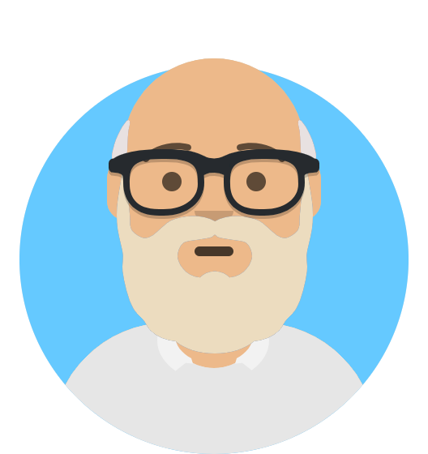



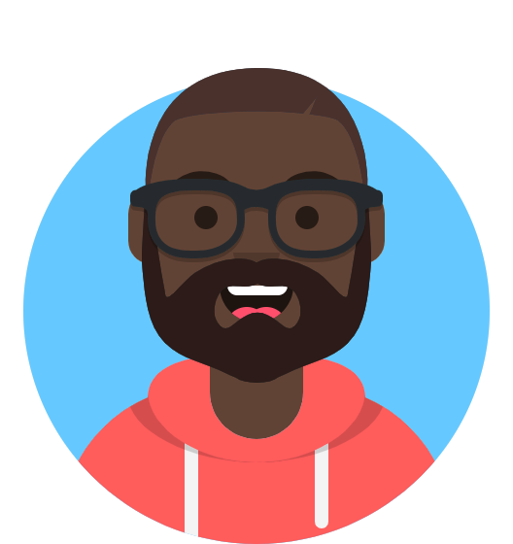

Meet the eLearning Services Team
Rhiannon James Chris Alex Katie
803-777-1800
http://go.sc.edu/BlackboardHelp
Susan Daniel
Notes:
Rhi
Over 125 years of institutional knowledge on this team!
We have 2 new comers, 3 if you include Rhi
Blackboard experts!

Slide 6



Supported Enterprise services
Notes:
Rhi
eLearning Services, in collaboration with other areas in TLT and CTE as well, provides support for the Enterprise Learning Management System Blackboard for course delivery, Zoom for video web conferencing, and Panopto for video content management. And many many more tools within blackboard.

Slide 7

Learning Management System
Blackboard
Notes:
Pass it over to Katie

Slide 8

USC UCV Resources for faculty
Blackboard Learn Ultra Resources – CTE Website - http://go.sc.edu/ultraresources
Blackboard Learn Ultra Resources from Anthology - https://help.blackboard.com/Learn/Instructor/Ultra
Ultra Checklist - ensure your course is fully prepared for teaching in the UCV environment
Small group trainings and consultations by request from eLS and CTE
    Meet with an Instructional Designer at Center for Teaching Excellence (CTE)
    Consult with a Blackboard Admin with eLearning Services
CTE Template - import into your Ultra sandbox and/or your existing Ultra course.
Columbia Office of the Provost Website – Transitioning to Blackboard Learn Ultra – http://go.sc.edu/ultra
Notes:
Katie
We will do the quickest demo in history in just a few minutes but we wanted to share some resources for you to look back on

Slide 9
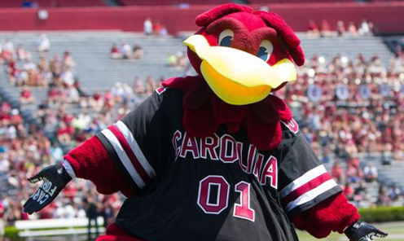
USC UCV Resources for students
eLS Blackboard Ultra student intro video https://uofsc.hosted.panopto.com/Panopto/Pages/Viewer.aspx?id=fda2dc70-46dc-4ed8-98b2-b1c901712a2f
Blackboard Ultra articles for Students https://help.blackboard.com/Learn/Student/Ultra
Blackboard Ultra Student YouTube videos (from Anthology) https://www.youtube.com/playlist?list=PLontYaReEU1th3bHYy_JWWkyZCW0ZM3r0
Notes:
Katie

Slide 10

Blackboard Ultra Training
    CTE/eLS Workshop Schedule
    https://sc.edu/about/offices_and_divisions/cte/events_calendar/blackboard_learn_ucv/index.php
    *registration required
Notes:
Katie

Slide 11
Video Web Conferencing
Zoom
Notes:
Katie

Slide 12
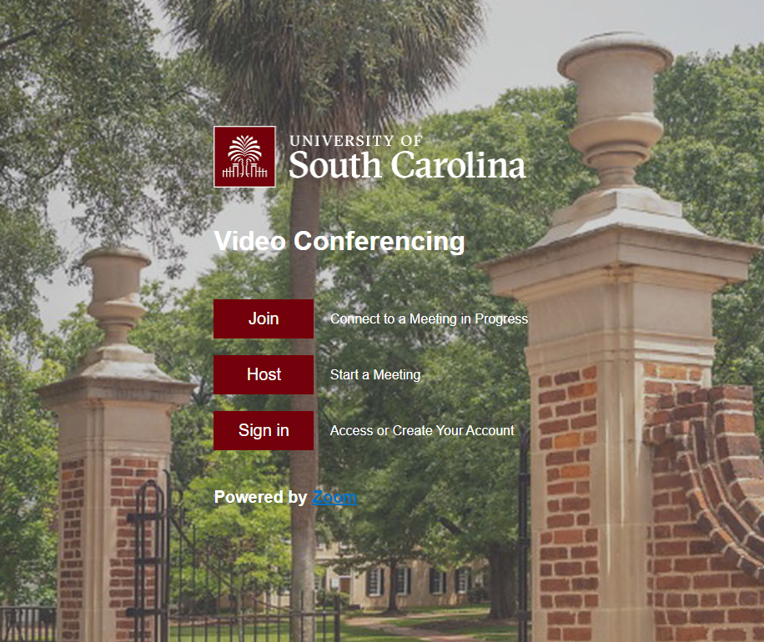
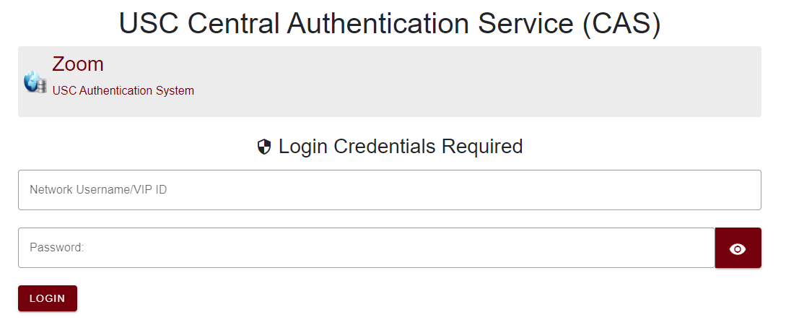
Accessing Zoom
USC Zoom URL: sc-edu.zoom.us
Notes:
Katie
You can access Zoom outside of Blackboard as well
Students also have access to utilize Zoom

Slide 13
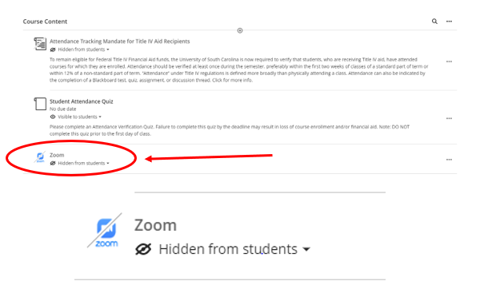
Zoom in Blackboard
Once in Blackboard, Zoom has been added to all Fall 2024 courses in the content area. Also located in:
  Details & Actions menu – Books & Tools, available tools
  Content Area – hit the “+” and click Content Market, locate Zoom. Click the “+” to add it to your course.
Notes:
Katie
Once in blackboard, access your course, locate the Zoom link. You will setup your Zoom meeting directly within Blackboard in your course, then make sure it is AVAILABLE to your students to see.

Slide 14

Getting help

Slide 15
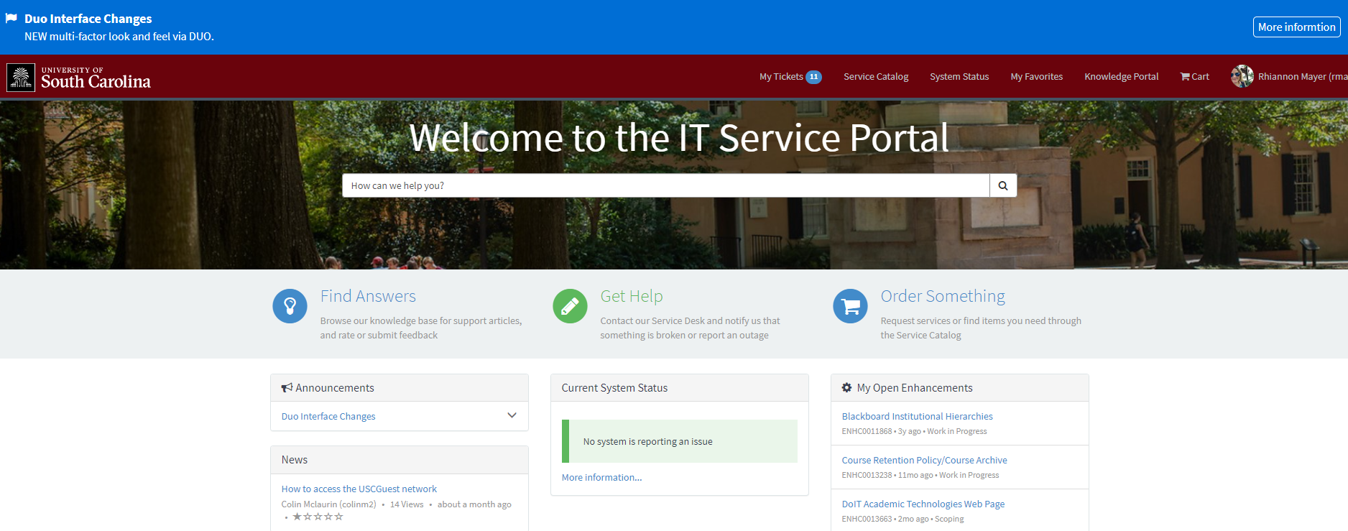
Requesting Help from Doit
IT Service Portal
IT Service Desk
803-777-1800
24/7 Technical & Blackboard Support
  https://sc.edu/ithelp
Knowledgebase
Service Catalog
Report Outages
Check System Status
View your submitted tickets
Notes:
Katie

Slide 16
Demo time
Notes:
Introduction to Blackboard (USC’s Learning Management System)
Recent transition to Blackboard Learn Ultra Course View
Whether you have inherited a course or are starting from scratch, we can help you
Transitioned from Collaborate to Zoom
Topics
Locating courses in Blackboard
Base Navigation
View profile, etc.
Do you see the courses you are teaching? If not, reach out to your college to ensure you are listed as the instructor of record
Course Availability – by default, your course is available and visible to students
Post Syllabus
Announcements
Set up your virtual classroom if it applies to you

