Slide 1

Supporting and Engaging First-Generation Students
in High Impact Practices
First-Generation Symposium
Friday, March 27, 2026
Jamil D. Johnson, Ph.D.

Slide 2
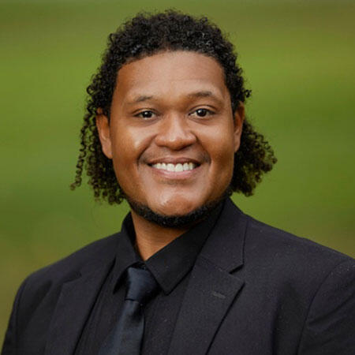
About Jamil D. Johnson, Ph.D.
Research Agenda
First Year Experience, specifically, First Year Seminars
African American men and their experiences throughout the PK-20+ educational pipeline
First-generation and historically marginalized populations access, participation, and experiences in undergraduate and graduate programs.
Recent Publications
2023 National Survey on the First-Year Experience
Celebrating Students and their Experiences at HBCUs
Grants
Primary investigator examining first-generation student experiences and engagement in high-impact practices (Student Affairs and Academic Support Faculty Research Fellow, University of South Carolina)
  **The initial findings shared today are from this project
Jamil D. Johnson, Ph.D.
Clinical Assistant Professor
Higher Education and Student Affairs
Department of Leadership, Learning Design, and Inquiry
Scholar-in-Residence
National Resource Center for the First-Year Experience and Students in Transition
University of South Carolina

Slide 3

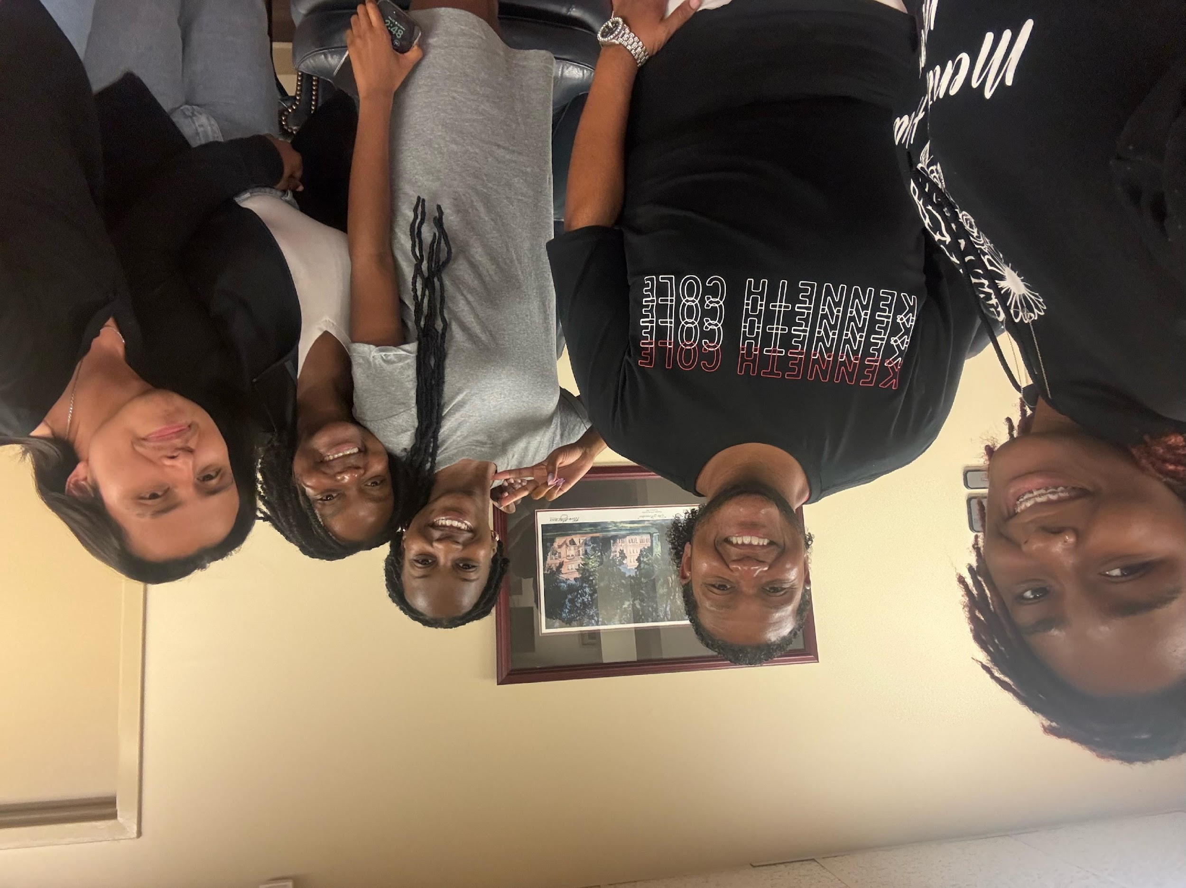
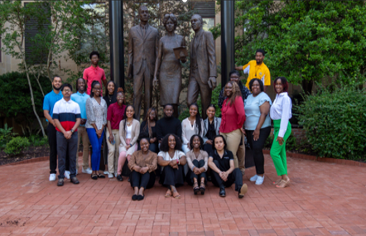
Trio Ronald E. McNair Scholars

Slide 4
Group Discuss: First-Generation Students
With colleagues around you, discuss any of the following questions
If you are a first-generation student, what is your story (lived narrative)?
In your institutional role, how do you leverage and/or support first-generation students on campus?
What are common challenges first-generation students face in your office and/or direct role? How are these resolved?

Slide 5
Aliyah Discusses Her Experiences
Aliyah discusses her experiences navigating co-curricular involvement during the first-year on the USC campus:
I wanted to join one of the public health clubs, and walked into that room, and everybody looked at me like I was a unicorn. Having that many eyes on you, especially that many eyes on you that don't look like you, whether you’re a people person or not, can make you anxious. I walked in there and walked around for
like two minutes, and walked right back out the door, because it just didn't feel like the space for me.
With colleagues around you, interrogate Aliyah’s experience. Some considerations:
Does Aliyah’s experience surprise you?
In your analysis, is there a problem (issue)? How would you navigate through the problem to advocate?
In your institutional role, how does Aliyah’s experience translate to other experiences first-generation students may have on campus? How are these navigated and supported?

Slide 6
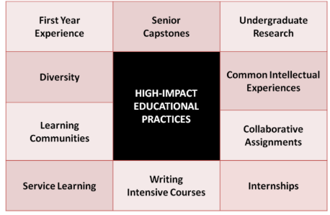
Engagement in High-Practices
The critical importance of engagement in at least one high-impact practice (HIPs) during an undergraduate student’s education career is clear to their success (Kuh, 2008).
Students who engage with HIPs are more likely to be engaged with campus peers, staff, and faculty through intentional and meaningful interactions.
As an institution, we promote, encourage, and in some cases (require) students to engage with offices to learn more about various opportunities.

Slide 7
Group Discuss: High-Impact Practices
On the surface, we know high-impact engagement promotes success.
With colleagues around you
Discuss the experiences of first-generation student engagement in high-impact practices on the USC campus.
How does the conversation shift as we advocate for first-generation students' engagement? Potential challenges, etc.
Where are the gaps in engagement? Why do these gaps exist? What is the issue?

Slide 8
TRIO McNair (Undergraduate Research) Experience
Smartwater discusses their TRIO McNair (Undergraduate Research) experience:
McNair, I feel like that program has actually helped me gain other experiences within campus, like being an assistant position in the lab which I would have never been able to do by myself if it wasn't for the McNair Program, which I am very fortunate to be part of. And now wanting to go to graduate school especially because not that many people get exposed to that as first-gen.
K2 highlights his experience as a Black man and navigating leadership experiences:
Being a Black male, I don't let it discourage me. I use it a drive. I am typically the only one in many situations on campus and not many of us are in leadership positions. Now I use that as motivation to be in exec board positions and in opportunities where you do not see us represented.
With colleagues around you, in what ways do these narratives disrupt the informal assumptions and scholarship around first-generation student engagement?

Slide 9
Research And Rhetoric
Disrupts the deficit assumptions (informal) of first-generation students and their campus engagement. First-generation students bring with them a wealth of assets (often invisible) of assets that institutions do not recognize or value (Yosso, 2005), (Johnson, forthcoming).
Research and rhetoric on first-generation students tends to focus on their limited social support and low socioeconomic status background, when compared to continuing education students (LeBouef & Dworkin, 2021).
Yet this assumption dismisses the strong familial relationship, connections, and resilience that first-generation students often bring with them to campus (Canning et al. 2020).
To understand and advance first-generation student outcomes and success, educators, leaders, and practitioners must aim to empower their first-generation students by identifying and leveraging individual strengths to increase their likelihood of success and promote self-efficacy in an asset-based approach (Kamalumpundi et al. 2025), (Johnson, forthcoming).

Slide 10
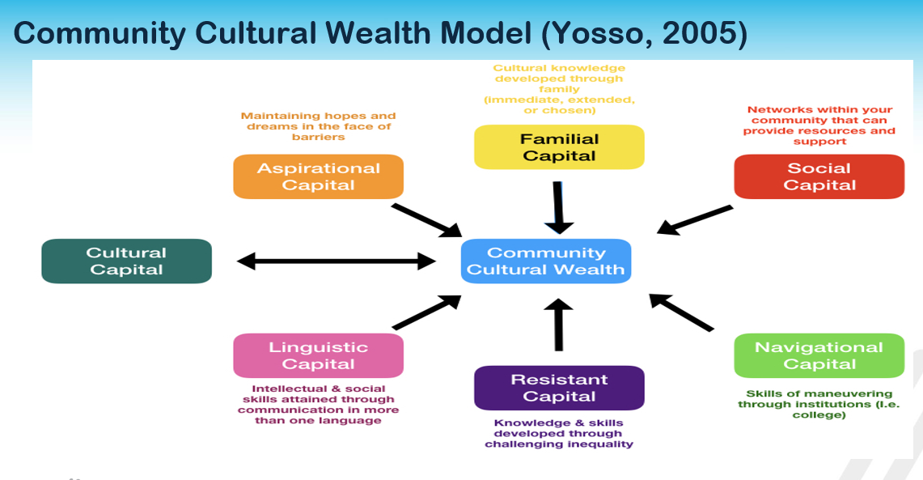
Community Cultural Wealth Mode Image

Slide 11
Community Cultural Wealth (Yosso, 2005) - 1
Social capital - Networks of support
Across the board, first-generation students consistently noted TRIO Center, First- Generation Center, Center for Student Engagement, Student Success Center (specifically SI support), Peer Mentors (and related roles) as strong forms of social support.
Cultural capital - Knowledge, knowing how the (system) of education works. These skills are acquired through experiences (i.e., Study Abroad, Undergraduate Research)
Across the board, first-generation students highlight the role and influence of peers, staff, and faculty. **Impact/mentoring**
Smartwater discusses their TRIO McNair (Undergraduate Research) experience:
McNair, I feel like that program has actually helped me gain other experiences within campus, like being gaining my research assistant position in the lab which I would have never been able to do by myself if it wasn't for the McNair Program, which I am very fortunate to be part of. And now wanting to go to graduate school especially because not that many people get exposed to that, I feel like that's fantastic.
Remember, advocate and support our students.

Slide 12
Community Cultural Wealth (Yosso, 2005) - 2
Familial Capital - Cultural knowledge and emotional support from family members (beyond money), challenges (culture shock)
James noted of his family and responsibilities:
Most students will get a bunch of help from their family, whereas I'm helping my family back home. I'm still doing other things and having responsibilities while up here and back home that many people on campus do not understand.
**Our first-generation are working full-time positions and being full-time students** Do we understand that in financial aid? Bursar? Professors?
Linguistic Capital - Intellectual and social skills through communication.
Examples: In the classroom (for example), allow students to self-reflect and celebrate their own lived experiences (storytelling).

Slide 13
Community Cultural Wealth (Yosso, 2005) - 3
Navigational Capital – how students navigate systemic barriers, discrimination, or unsupportive environments. Navigating chilly (campus climates), sense of belonging (fit)
Jason discusses his experiences as a student in a specific major:
Maybe improve the diversity within classrooms. I'm not sure how it is in other colleges, but in business school, I'm like, one of three, one of two black people in the entire lecture. So, you know, it kind of feels like, Where is Waldo sometimes, you know, you just looking around you, just trying to find somebody that looks like you. I guess, because sometimes it feels like everybody's friends besides you, and then that feels like you just being excluded.
This starts here, at a First-Generation Symposium but also other aspects in the system of higher education (New Faculty Orientation, Center for Teaching and Learning).

Slide 14
Community Cultural Wealth (Yosso, 2005) - 4
Aspirational Capital – Ability to maintain dreams for the future, even when barriers or perceived barriers are present.
James discusses his academic aspirations:
Not dropping out yet. I'd say I know a couple people who ain't even finished they first semester. I know I failed a couple of tests, and I was like, I don't know if college is for me. But I’m still doing it, for me and for my family. Im still here!
Resistance Capital – Knowledge and skills developed by challenging inequality.
Ivory discusses her experiences navigating a STEM major.
Being a black woman in STEM like you're in this area where there's a lot of white males, and they just look at you like, Oh, you're not supposed to be here. Or t hey act like you don't know what you're talking about, when, in reality you do! I think it’s important for just POC (People of Color) in general, women in general, You’re not going to put me out of here, I'm going to be here and be successful!”

Slide 15
Practices To Increase First-generation Student Engagement - 1
Practices to Increase First-Generation Student Engagement
Identify intentional ways to increase the engagement.
Go to the students. It is one thing to pass out a flyer but go their organizational meetings (do not send a template email).
Highlight (the invisible) narratives of those who have participated in high-impact practices so that potential students see themselves in the story.
As we will see in some of the student narratives, peer mentoring and first-year seminars both are powerful influences on first-generation students' experiences and engagement.

Slide 16
Practices To Increase First-generation Student Engagement - 2
Practices to Increase First-Generation Student Engagement
Hire first-generation students (undergraduate and graduate). Students are more likely to engage if they see someone who looks like them (i.e., similar experiences).
Develop relationships with other first-generation faculty, faculty are often left out of the conversation – (though our numbers are equally very low, faculty of color) to help recruit and promote opportunities and serve as mentors. >> Faculty and student relationships is one of the most powerful student success outcomes.
Build and sustain relationships with TRIO Programs and First-Generation Centers on campus.

Slide 17
Max Discusses The Impact Of TRIO
Max discusses the impact of TRIO on his access to USC and pathways navigating campus:
I would not have come to this college because TRIO wouldn’t have accepted me, if I'm real, but it's definitely been a great impact on my whole college experience. I have a great TRIO mentor who I am always around. TRIO has been a very big part of my college experience so far. So it's definitely been probably the number one impact.
I want to shout out everybody who helped me across campus over the times and just directed me and the staff, because the staff are so nice, and they treat everybody so kindly with respect. So I definitely do appreciate that.

Slide 18
Jenny Notes Of Her U101 TRIO Experience
Jenny notes of her U101 TRIO experience:
We had fun in there and stuff. And honestly, thank God I had the TRIO section, because it was actually like people of color in there. Like it wasn't majority of like white people. So it was, like, more comfortable, I guess, for me in a way. I love the teacher. She's great. I love my mentor too. She's great.

Slide 19
Gap In The Hierarchical Structure
A brilliant finding was noted by James, a gap in the hierarchical structure of higher education staff that is often overlooked and even more so neglected on college campuses:
The custodians in the residence hall are nice to have conversations with. If you are having a stressful or rough day, they take a minute or two to say what’s up and see how you are doing. And learn some neat facts about you. Sometimes that means a world of difference and I really appreciate it.
**And vice versa (often feel neglected)

Slide 20
Thank You, Contact And Questions
My sincerest gratitude to
J. Rex Tolliver, J.D.
Vice President for Student Affairs and Academic Support
Silvia Patricia Rios Husain, Ph.D.
Associate Vice President for Student Success
Strengthening the pathway for faculty to engage in high-impact research projects specific to our student populations.
LaNaé Budden, Ed.D.
Director First-Generation Center
And to our first-generation leaders, advocates, and staff.
Thank you, Contact and Questions
Jamil D. Johnson, Ph.D.
jj117@mailbox.sc.edu
305 Wardlaw (College of Education)

