Slide 1


Reclaim the Narrative
Higher Ed
for the
Common Good
1
1

Slide 2
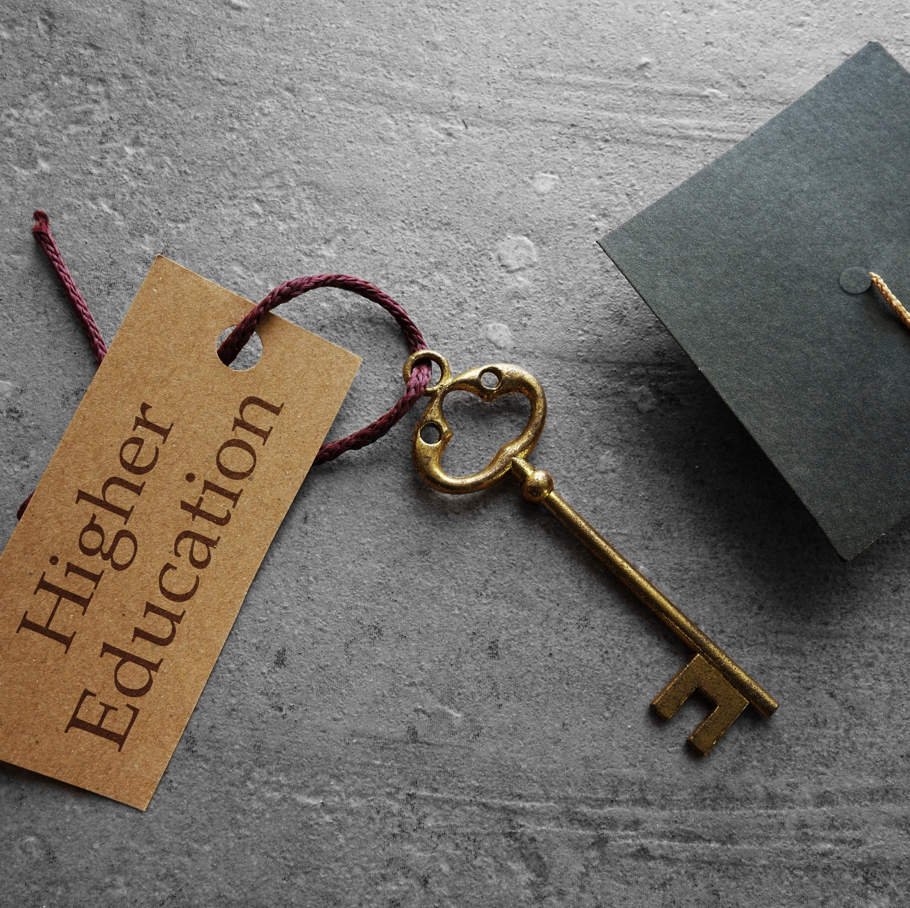
Reclaim the Narrative at USC Columbia
Higher Education for South Carolina’s Common Good
South Carolina’s flagship public research university
Educates and serves students who stay and lead in the state
Research, teaching, and service with direct public impact
Faculty and staff work often misunderstood or invisible to the public
Reclaim the Narrative
Supports faculty & staff voices (not institutional messaging)
Centers shared public values
Flexible, voluntary, locally adaptable
2

Slide 3

Why Narrative Change Matters
  It’s not everything — but it’s essential.
  Takes time, many voices, shared values.
  Organizing and lawsuits defend; stories renew.
  Together, they build trust and power.

Slide 4
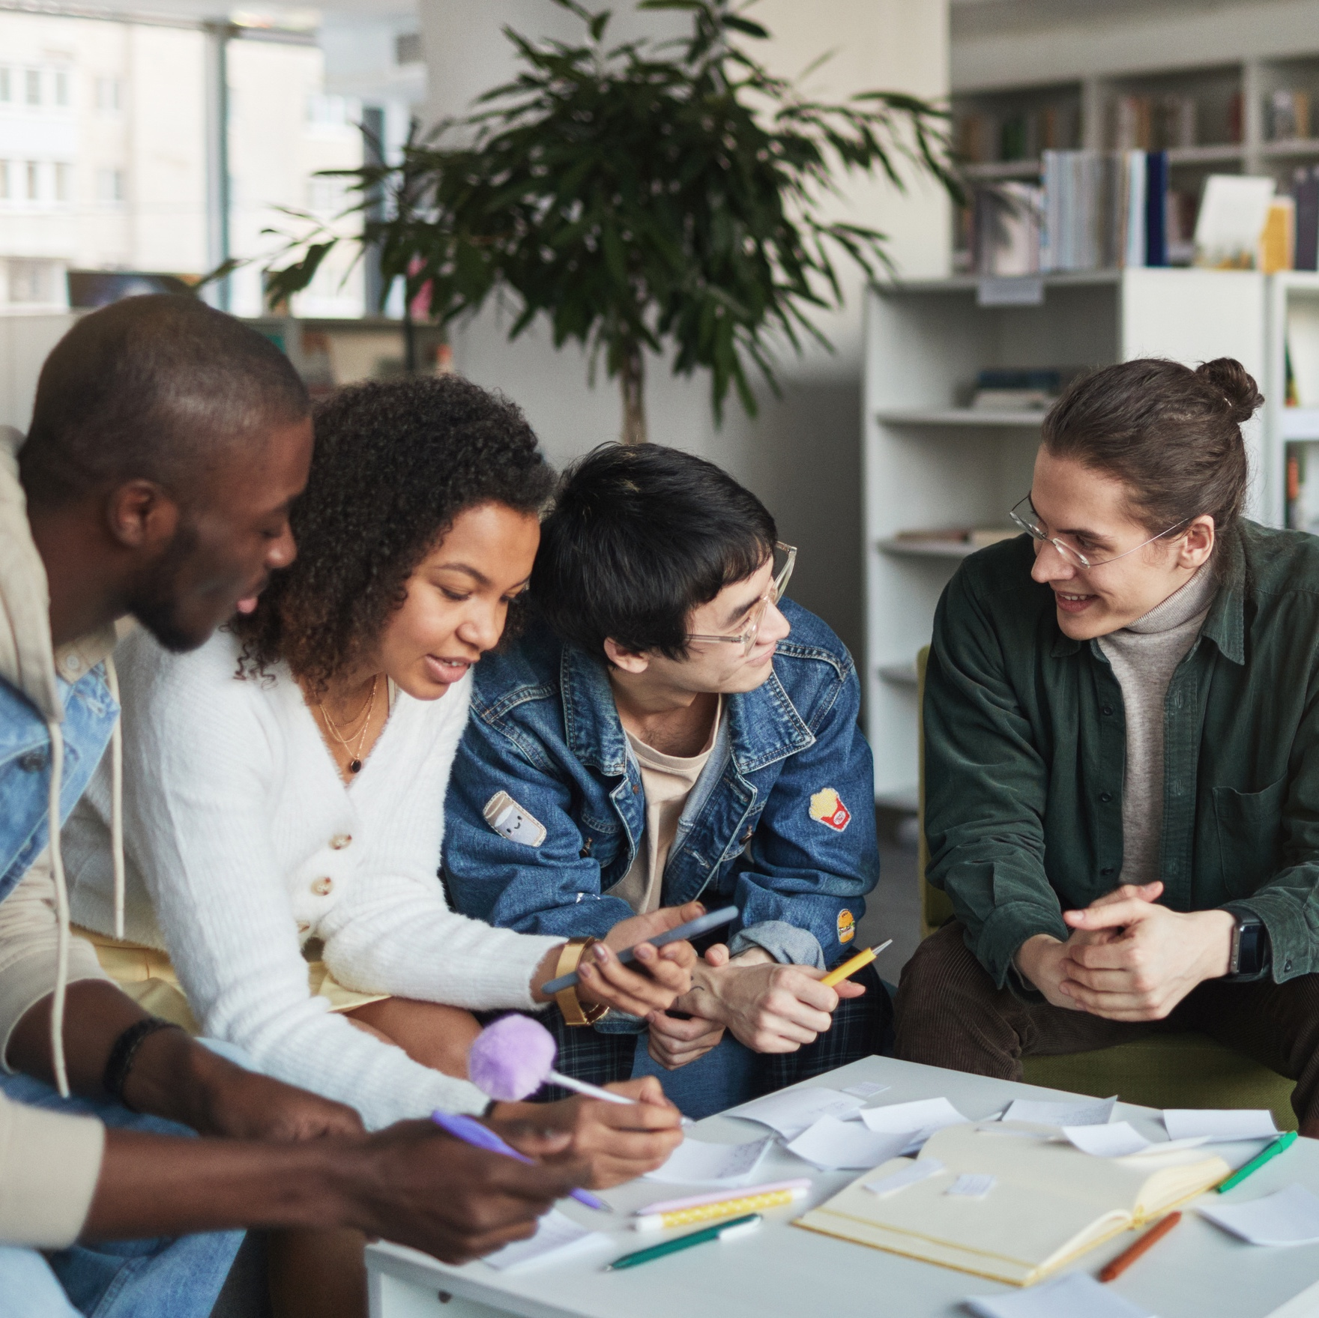
It’s Up to Us to Tell the Real Story
  Make it local
  Make it human
  Make it hopeful
  Make it public-serving

Slide 5
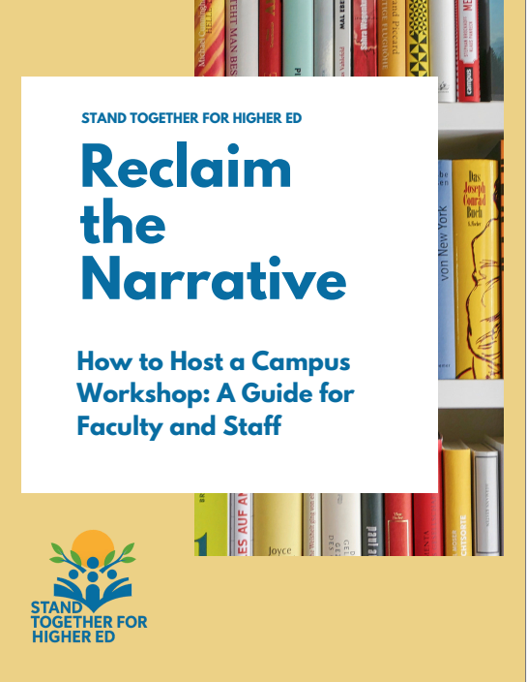
Reclaim the
Narrative Materials
  On the Stand Together for Higher Ed website, you will find:
  Presentation slides
  Presentation script
  Booklet of materials
  https://www.standtogetherhighered.org/resources

Slide 6
Reclaim the Narrative
Defend Higher Education
  Join with colleagues on your campus
  Use the toolkit and share your stories
  Stay connected — more trainings and national actions ahead
  Join (it’s free!) and find workshop materials: standtogetherhighered.org
  Q & A if we have time

