Slide 1

Travel study
SPAIN 2026

Slide 2

Ciee

Slide 3

About ciee

Slide 4

CIEE

Slide 5

Program overview

Slide 6

dates
10 days, 9 nights
May 8-17, 2026

Slide 7


Slide 8

Seville
May 8-12

Slide 9

seville

Slide 10


seville

Slide 11

Alicante
May 12-17

Slide 12


alicante

Slide 13
details
Health, safety, and security
Transportation
Meals
Accomodations
Cultural activities/visits

Slide 14

Health, safety, and security
Pre-departure orientation to prepare participants for arrival on site.
On-site orientation once we arrive.
A CIEE staff member will accompany the program on all CIEE arranged program events.
CIEE provides a 24/7 emergency phone support for the duration of the program.
CIEE provides travel insurance for all participants

Slide 15

transportation
Group Airport Transfer upon arrival and departure (Seville)
Public Transportation pass for Seville component of the program
Airport or Train transportation to Alicante
Group Airport or Train Transfer upon arrival and departure (Alicante)
Public Transportation pass for Alicante component of the program

Slide 16

meals
Welcome Lunch (x2)
Farewell Dinner (x2)

Slide 17

hotel
Hotel: double occupancy for four (4) nights (Seville)
Hotel or Residence Hall: double to triple occupancy for five (5) nights (Alicante)

Slide 18

Cultural activities - seville
Enjoy a Tour of Seville
Visit Alcázar Royal Palace
Visit Cathedral & Giralda
Enjoy a Walking Tour Plaza España and Plaza America
Visit a Fine Arts Museum
Visit an Additional Museum
Enjoy a Guided Tour of Cathedral
Enjoy a Flamenco show

Slide 19

Cultural activities - alicante
Enjoy an Alicante city tour
Visit Santa Barbara Castle
Enjoy a biking tour
Engage in Watersports activities
Visit an Archaeological Museum

Slide 20
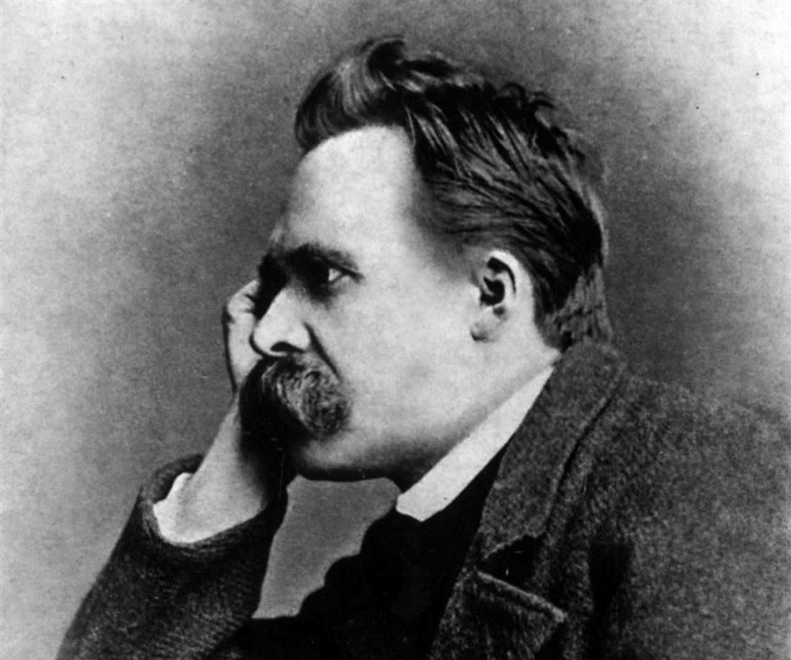

Phil 103 special topics in ethics and values

Slide 21

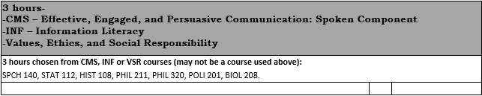
Vsr credit or elective

Slide 22
USCL scholarships
Lancaster County Commission Grant ($2,000) for USC Lancaster Students with 3.0 GPA or higher who are participating in Travel Study
Collins Family Endowed Scholarship Fund for Travel Study The scholarship(s) will be awarded by the USC Lancaster Scholarship student who wishes to participate in USCL's Travel Committee to student(s) based upon recommendation of the faculty in charge of the travel opportunity and on the student’s expression of reasons in which they desire to participate (through a short essay) in the travel study program and on the student’s demonstrated financial need. Students must have a 2.5 GPA minimum.
Billy Hogge Travel Study The scholarship(s) will be awarded by the USC Lancaster Scholarship Committee and will support students from Chesterfield or Lancaster County, or a deserving student who wishes to participate in USCL's Travel Study Program. Students must have a 3.0 GPA minimum.
Medford Travel Study Endowed Scholarship Fund The scholarship(s) will be awarded by the USC Lancaster Scholarship Committee to a deserving Study Program. Students must have a 3.0 GPA minimum.

Slide 23
USC system scholarships
Carolina Engage Grant The Carolina Engage Grant provides students up to $500 to engage beyond the classroom. Research shows students who participate in beyond the classroom experiences can more easily make the transition from college to the work force and are more likely to be engaged members of their communities. Complete the application form linked below by describing in detail how the beyond the classroom experience connects to your personal, professional, and academic goals. Priority is given to students demonstrating significant need to engage in meaningful experiences.

Slide 24



For more info
PETER SEIPEL
pseipel@mailbox.sc.edu
USCL Travel Study
ENGAGE Grant Opportunity for all UofSC students interested in Study Abroad
CIEE Custom Programs

